Slide 1
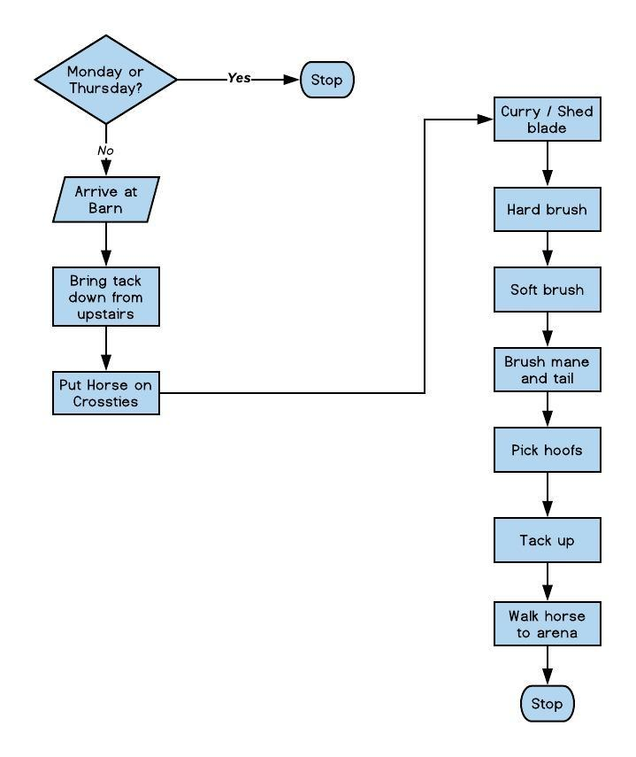
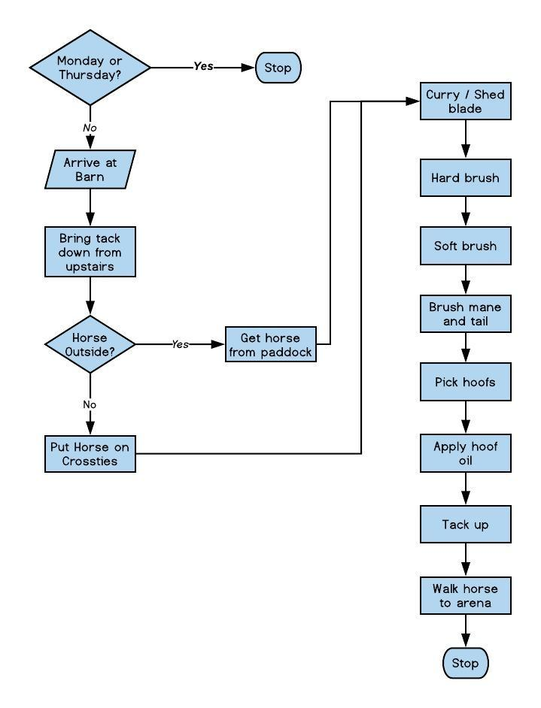
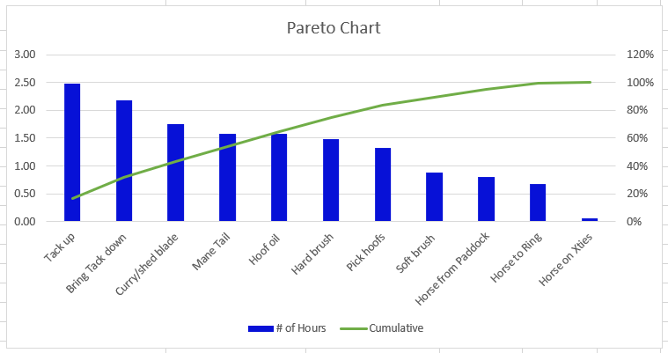
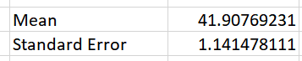
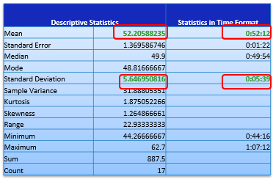
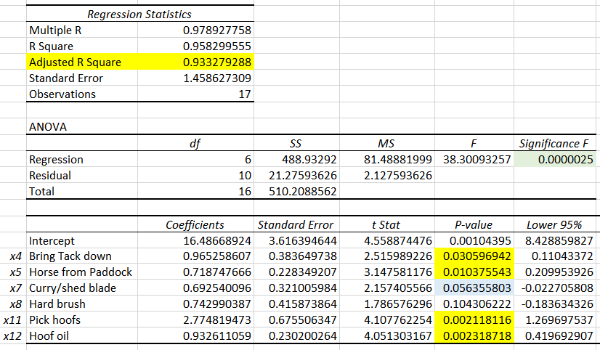
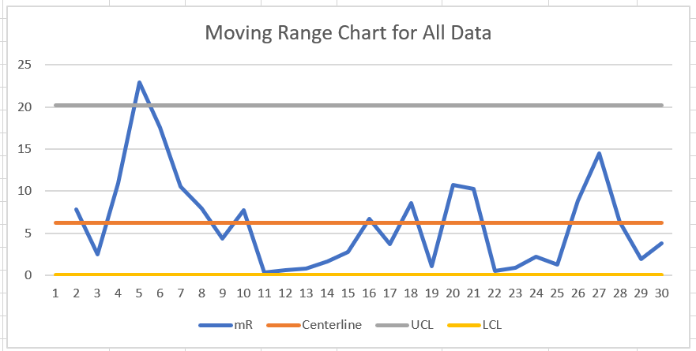
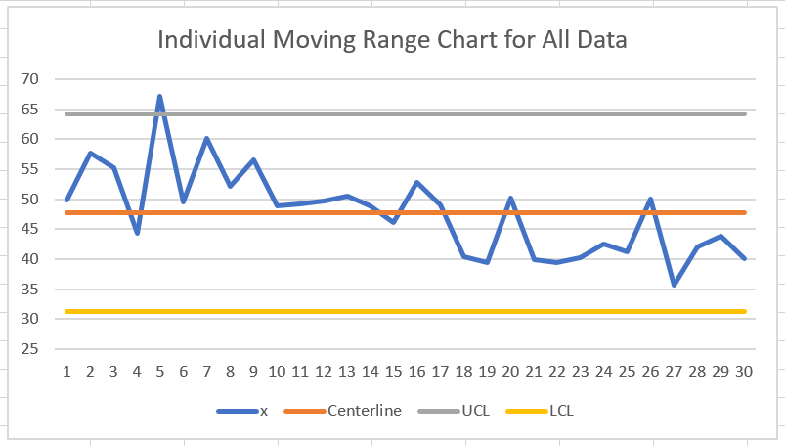
Horse Ride Preparation Process Improvement
Joyce LJ Woznica
Key Dates --->
Launch 10/4/2018
Define 10/4/2018
Measure 10/7/2018
Analyze 11/6/2018
Improve 11/7/2018
Control 11/30/2018
DEFINE
MEASURE
ANALYZE
IMPROVE
Problem: It takes too long to prepare my horse for riding and I run out of time to actually ride when the arena is not busy.
Data Collection: Collect 14 variables: 3 discrete, 11 continuous associated with ride preparation process.
Hypothesis Testing: H₀: µ₁ ≤ µ_{2 ,} H_{a}: µ₁ > µ₂
P = 0.00000000384
So, since p < α = 0.05, then we reject H₀ and conclude that there was process improvement.
Improvements Made: Three improvements were made in my process:
Put ½ of my tack in my car
Had someone bring horse inside
Applied hoof oil after I rode, so removed from the process
Multiple Linear Regression Analysis: In executing several iterations, it was clear that 3 or 4 input variables had direct correlation to my total time for preparation.
SQL After: 2.5
SQL Before: 1.6
Significant time being spent on a few tasks including bringing tack down and applying hoof oil.
x4 – Bring tack down
x5 – Get horse from paddock
x12 – Apply hoof oil
CONTROL
My xMR and iMR charts showed that my process is under control; however on day 5 of my pre-improved process, there was an issue with control.
Impact: If I cannot ride multiple times each week for at least 25 minutes each ride (target is 4 rides per week), the result is additional vet expenses. If this cannot be achieved, injections, medications and vet visits equate to additional expenses that can average $2,500 per year to handle his sacroiliac (SI) joint.
Reviewing day 5 (10/14/2018), I found that I took much longer than normal to bring my tack down, get the horse from his paddock and to tack up.
Chi-Squared Test (for α = 0.05, p = 0.149072804) did not prove relationship between horse being outside (in paddock) and total preparation time.
Averaging about 52 minutes with deviations of 5 ½ minutes. Almost 23 minute range between minimum and maximum times.
Continue to monitor process for control.

Slide 2
Process Map for Pre-Improvement Process
Process Map Explanation and Business Problem
The arena/ring at our barn is booked for nightly lessons after 7:00 PM each evening.
It is difficult, if not impossible to ride during lessons.
I do not get out of work until approximately 5:15 PM and have to change and leave for the barn.
My travel time to the barn is usually 30 minutes.
I work on Monday nights and have class on Thursday nights, so I cannot ride those days.
My trainer rides my horse one day per week – usually on Fridays.
Process Details The process started from the moment I stepped out of my car at the barn.
Tack is stored upstairs in the hayloft and requires two trips for me to bring everything down which wastes time:
Helmet
Saddle, saddle pads, girth
Brushes
Bridle
If my horse is not already in his stall, then I have to walk to his paddock and bring him inside to put on the crossties. If he is inside, I just take him from his stall to the crossties. The former was included in the “Get horse from paddock” task in the process map.
The remaining steps are accomplished in the same order each time I prepare to ride.
Comments/Observations
The process is lengthy and time consuming.
The process gives me only 15 to 20 minutes on average to ride my horse which is not meeting my objectives.
There are improvements that can made to expedite the process.

Slide 3
Data Measurement Plan
Performance Measure | Data Source / Location | How Collected | Data Collector | When Collected | Target Sample Size
Weekend or Weekday | Excel Spreadsheet | Recorded a 1 for Saturday or Sunday. Recorded a 0 for Monday through Friday. | Self | 10/7 – 12/2 | 40
Ridden Day before – if the horse was ridden the day before by me or someone else. | Excel Spreadsheet | Recorded a 1 for Yes. Recorded a 0 for No. | Self | 10/7 – 12/2 | 40
Horse In or Out | Excel Spreadsheet | Recorded a 1 for In. Recorded a 0 for Out. | Self | 10/7 – 12/2 | 40
Minutes Spent bringing tack down from upstairs | ATracker | Start task when leave stall, end task when all tack is by stall | Self | 10/7 – 12/2 | 40
Minutes Spent bringing horse inside from paddock | ATracker | Start task immediately after previous task ends, end task when horse is on crossties. | Self | 10/7 – 12/2 | 40
Minutes Spent bringing horse to crossties | ATracker | Start task immediate after previous task ends, end task when horse is on crossties. This is 0 if horse is outside in paddock. | Self | 10/7 – 12/2 | 40
Minutes Spent currying (curry brush) and/or using a shed blade on horse to clean dirt, remove hair, etc. | ATracker | Start task immediately after previous task ends, end task when next brush is selected. | Self | 10/7 – 12/2 | 40
Minutes Spent hard brushing to remove dirt brought to surface from curry | ATracker | Start task immediately after previous task ends, end task when next brush is selected. | Self | 10/7 – 12/2 | 40
Minutes Spent soft brushing to smooth hair on face and body | ATracker | Start task immediately after previous task ends, end task when next brush and product are selected. | Self | 10/7 – 12/2 | 40
Minutes Spent detangling and brushing mane and tail, and applying product | ATracker | Start task immediately after previous task ends, end task when hoof pick is selected. | Self | 10/7 – 12/2 | 40
Minutes Spent lifting and picking all dirt, rocks, debris out of each hoof and scratching off dirt on hoof | ATracker | Start task immediately after previous task ends, end task when hoof oil and brush are selected. | Self | 10/7 – 12/2 | 40
Minutes Spent applying hoof oil to each hoof after brushing off any dust from hoof | ATracker | Start task immediately after previous task ends, end task when saddle pad is selected. | Self | 10/7 – 12/2 | 40
Minutes Spent tacking horse including: saddle pad, saddle, girth, bridle, grabbing crop | ATracker | Start task immediately after previous task ends, end task when all tack is on horse. | Self | 10/7 – 12/2 | 40
Minutes Spent walking horse to arena for riding | ATracker | Start task immediately after previous task ends, end task horse enters ring for riding. | Self | 10/7 – 12/2 | 40

Slide 4
Data Collection Method
Data Collection Explanation
General Information
A tool called “ATracker” (http://www.wonderapps.se/atracker/) was used to assist in capturing each task in the process map. This tool had both a iPhone application along with an ability to download the data in a spreadsheet for later usage.
Manipulation of the spreadsheet was needed to change columns from vertical to horizontal and to add discrete data collected.
Each task was ended/started when I put down the brush and picked up the next tool in the process. This was determined because of the minimal seconds to put one brush away and grab the next. The app allowed just one touch to end one task and another touch (like a double touch) to start next task to minimize collection errors.
I collected data each day of the week that I was able to ride – which was not as often as I would have liked due to weather and other commitments beyond my control (so they were not captured in the data collection).
Data Collected
A total of 14 variables was collected.
Both continuous and discrete data were collected.
All continuous data was recorded in minutes and seconds.
Discrete Data
Discrete data captured for 2 additional inputs:
x1 – Weekend (1) or Weekday (0)
x2 – Ridden Day Before (1) or Not (0)
x3 – Horse In (1) or Out (0)
The output (or y) variable of my data was the Total Minutes that it took me each day to complete all the tasks it takes to prepare to ride.
Continuous Data
Continuous data was time for each task in the map for eleven (11) inputs as follows:
x4 – Bring tack down
x5 – Get horse from paddock
x6 – Put horse on crossties
x7 – Curry / shed blade
X8 – Hard brush
x9 – Soft brush
x10 – Brush mane and tail
x11 – Pick Hoofs
x12 – Apply hoof oil
x13 – Tack up horse
x14 – Walk horse to ring to mount and ride
Days of Collection
Pre-Improvement State – Data collection started on October 7, 2018 and there were 17 days collected between that date and November 6, 2018.
Improvement State – Data collection started on November 7, 2018 and there were 13 days collected between that date and December 2, 2018.

Slide 5
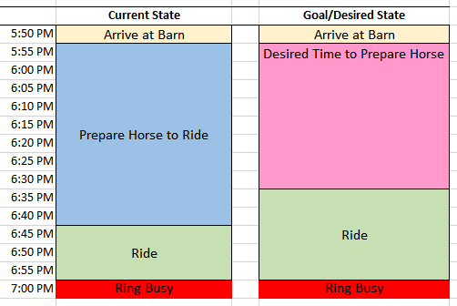
Goals and Measurements for Success
Goal
My goal is to increase my riding time to at least 25 minutes each ride which would mean decreasing the time required to prepare for riding by 20% giving me another 10 minutes to ride.
How Derived
The arena/ring is free from busy lessons until 7 PM and I get the barn between 5:45 PM and 6:00 PM – usually by 5:55 PM. With a mean current preparation time of 52 minutes and 12 seconds (my baseline), that would mean that I am in the ring to ride usually around 6:45 PM – only giving me a total of 15 minutes to ride before the ring is busy.
To get in the ring by 6:35 PM (allowing me 25 minutes to ride), I would merely need to shave off about 10 minutes off my preparation time. I decided to try to reduce my preparation time by 20% which would give me just over an additional 10 minutes based on my current data.
Goal => 52.2059 minutes * 20% = 10.44118 minutes
This was all determined by looking at the descriptive statistics of my “pre-improvement” or “current state” data as shown in the adjacent chart.
Descriptive Statistics |  | Statistics in Time Format
Mean | 52.20588235 | 0:52:12
Standard Error | 1.369586746 | 0:01:22
Median | 49.9 | 0:49:54
Mode | 48.81666667
Standard Deviation | 5.646950816 | 0:05:39
Sample Variance | 31.88805351
Kurtosis | 1.875052266
Skewness | 1.264866661
Range | 22.93333333
Minimum | 44.26666667 | 0:44:16
Maximum | 62.7 | 1:07:12
Sum | 887.5
Count | 17

Slide 6
Pre-Improvement Pareto Chart
Use of the Pareto Chart I selected to do a Pareto Chart to better understand where I was spending the most time in preparation to ride. Using this method, I was able to determine what tasks in my process were taking the most time so I could focus my improvements, where appropriate, in those areas.
Chart Creation
I charted the overall time spent on each task (in hours) during my initial 17 days of data collection each continuous data task (x variables) in my process.
Chart Interpretation As shown in the chart, there are several tasks where I am spending extensive time before riding preparing my horse. These include:
Tacking Up
Bringing my Tack Downstairs
Currying / Shed Blade
Brushing Mane and Tail
Applying Hoof Oil
Unfortunately, tacking up is not an area where much improvement can be applied. You have to put the saddle pad on, the saddle, the girth, the bridle, etc. This doesn’t change. This process is also compounded by a fidgety horse which is beyond my control.
However, I do have some control over my tack location and how long that takes me to bring to the aisle, the horse’s location and other tasks that appear time consuming on this chart.
This provided great insight into a good place to start to improve this process.

Slide 7
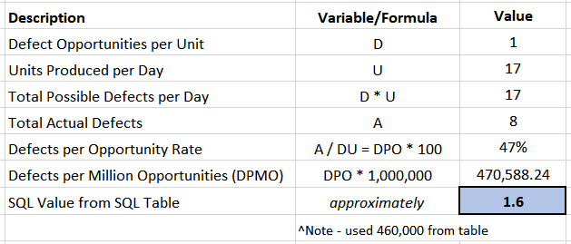
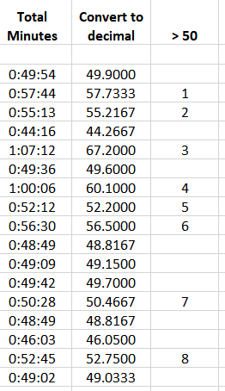

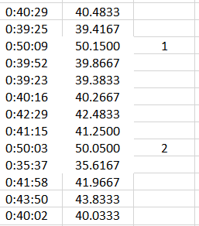
Sigma Quality Level (SQL)
Goal Restatement
My goal is to decreasing required preparation time for riding by 20%.
Operational Definition
As stated on slide #4, the total minutes required to prepare to ride my horse is our y for this project. The data was captured in minutes and seconds and then converted to decimals for calculations. Also detailed on slide #4, 11 continuous variables and 3 discrete variables were tracked in minutes and seconds for each time I prepared my horse for riding.
Sigma Quality Level based on Defective Parts per Million Opportunities (DPMO)
Pre-Improvement Data
Sigma Quality Level Information
This is the overall data for my SQL calculated:
A defect for my project was taking longer than 50 minutes in preparing my horse for riding.
I collected 17 samples pre-improvement.
Of the 17 samples, there is only 1 chance (each day) to be more than 50 minutes, so 1 possible defect per day.
In my data, there were 8 times that the total preparation time was more than 50 minutes.
Post-Improvement Data
Interpretation
There is significant improvement in the process with the SQL improving from 1.7 to 2.5.

Slide 8
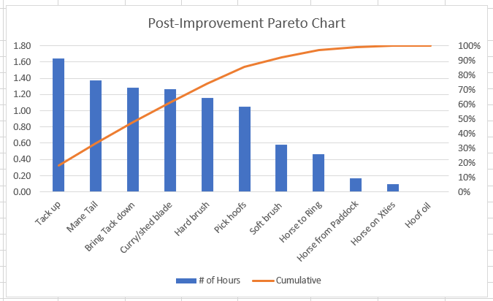
Improved Process Map
Process Map Modifications
As I looked at the original process, I found a few things that could be done right away. Some involved enlisting the help of others and some involved just changing my routine.
As per my original Pareto Chart (slide #6), there were some activities that were contributing most significantly to my total preparation time including: Tacking Up, Bringing my Tack Downstairs, Currying / Shed Blade, Brushing Mane and Tail, Applying Hoof Oil. However, some of these are difficult to change specifically and are uncontrollable. For example, if the horse rolled in the mud, currying takes longer as that is the step to remove dirt. I cannot control that behavior. The same goes for his mane and tail being extra dirty and requiring more time to brush. In viewing my chart, I did see some things that might help dramatically and were easy to change.
For example, putting hoof oil on and then riding the ring is actually nonsensical. I have done it for years, but it makes more sense to move this routine to after I have ridden as it is not necessary to do this before for the same benefits. So, I removed this from my preparation process.
I also found that I had to take 2 trips upstairs to bring down all my items (tack): saddle, saddle pad, quarter pad, girth, brushes, helmet, bridle, etc. So, I moved my helmet and brushes to my car, so that I could just take one trip upstairs for the remaining items.
Although not taking substantial time, I also found that I could ask the feeders to bring my horse inside I did not denote this in my process, because the feeders just brought him in first everyday for me. This saved some time, but added some to putting the horse on the cross ties.
As shown on slide #7, this new process had an improved Sigma Quality Level of 2.5 (significantly better than the 1.6 of the pre-improved process).

Slide 9
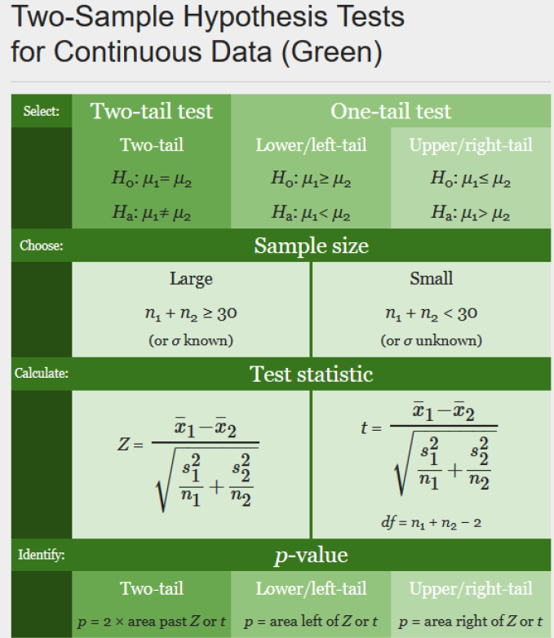
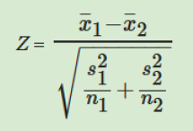
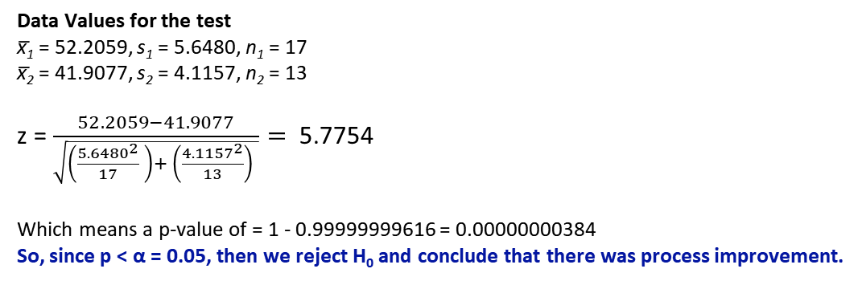
Hypothesis Testing
Hypotheses to be tested
Testing to see if there really is a difference between the two populations (before improvement and after improvement). We want to confirm that my preparation time was reduced in the second population.
Definitions
µ₁ = Mean of Pre-Improvement Data
µ₂ = Mean of Post-Improvement Data
α = 0.05, n ≥ 30 (because n = n₁ + n₂ = 17 + 13 = 30)
Which Test?
To determine which test and formulas to use, we have to look at our data:
Our data is time, so continuous.
We have two samples (pre and post improvement) testing the hypothesis shown to the left, so we have a one-tail, upper/right tail test.
Our n = n₁ + n₂ = 17 + 13 = 30. So we are on the cusp of the large sample size (n ≥ 30), so this means or our sample size is large.
Hypothesis
H₀: µ₁ ≤ µ₂ (post-improvement mean is less than or equal to pre-improvement mean – so no improvement shown)
H_{a}: µ₁ > µ₂ (post-improvement mean is greater than pre-improvement mean – so there was improvement)
We want to reject H₀ as we would like to see that improvement was realized with the changes implemented.
Data Values for the test
x̅₁ = 52.2059, s₁ = 5.6480, n₁ = 17
x̅₂ = 41.9077, s₂ = 4.1157, n₂ = 13
z = $\frac{52.2059−41.9077}{\sqrt{\left(\frac{{5.6480}^{2}}{17} \right)+ \left(\frac{{4.1157}^{2}}{13}\right) }}=$ 5.7754
Which means a p-value of = 1 - 0.99999999616 = 0.00000000384
So, since p < α = 0.05, then we reject H₀ and conclude that there was process improvement.

Slide 10
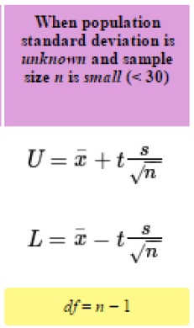
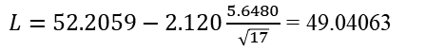
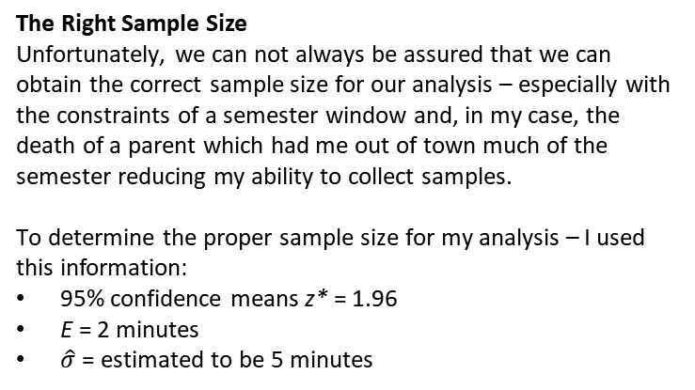
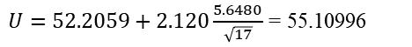
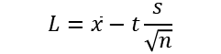
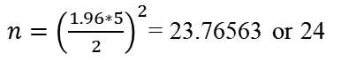
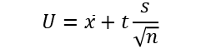
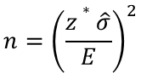
Confidence Interval and Sample Size
Confidence Interval for the µ
Unfortunately, we can not always be assured that we can obtain the correct sample size for our analysis – especially with the constraints of a semester window and, in my case, the death of a parent which had me out of town much of the semester reducing my ability to collect samples.
To determine the proper sample size for my analysis, I used this information:
n = 17
x̅ = 52.2059
s = 5.6480
α = 0.05, 95% confidence (p = 0.95)
This information would then imply that my degrees of freedom (df) is 16 (or n – 1). Using Table D (page T-11), my t statistic = 2.120.
That means that my Upper Limit and Lower Limits are as follows:
What does this mean?
This means that I am 95% confident that my mean is between 49.04063 and 55.10996 or 49.04063 ≤ µ ≤ 55.10996. That implies that my mean total time to prepare to ride would be between 49.04 and 55.11 minutes.
The Right Sample Size
Unfortunately, we can not always be assured that we can obtain the correct sample size for our analysis – especially with the constraints of a semester window and, in my case, the death of a parent which had me out of town much of the semester reducing my ability to collect samples.
To determine the proper sample size for my analysis – I used this information:
95% confidence means z* = 1.96
E = 2 minutes
$\hat{σ}$ = estimated to be 5 minutes
$$n={\left(\frac{z∗\hat{σ}}{E}\right)}^{2}$$
$n={\left(\frac{1.96∗5}{2}\right)}^{2}$= 23.76563 or 24
$$U=\overline{x}+t\frac{s}{\sqrt{n}}$$
$$L=\overline{x}−t\frac{s}{\sqrt{n}}$$
However, if I am okay with a margin of error of 3 minutes, my sample size only needs to be 11 days (10.5625). I also could have used a confidence interval of 90%, my sample size is just large enough (16.91266 or 17 days). So with this smaller sample of 17, I am taking a risk. This small of a sample increases the likelihood of a Type II error (failing to reject the null hypothesis when I should have).
verified with Excel CONFIDENCE.T(0.05,5.648,17) = 2.903934
$E=2.120\frac{5.6480}{\sqrt{17}}$ = 2.904063
$L=52.2059−2.120\frac{5.6480}{\sqrt{17}}$ = 49.04063
$U=52.2059+2.120\frac{5.6480}{\sqrt{17}}$ = 55.10996

Slide 11
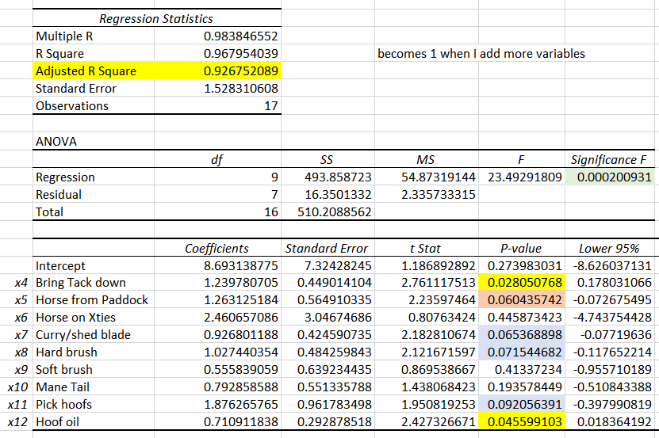
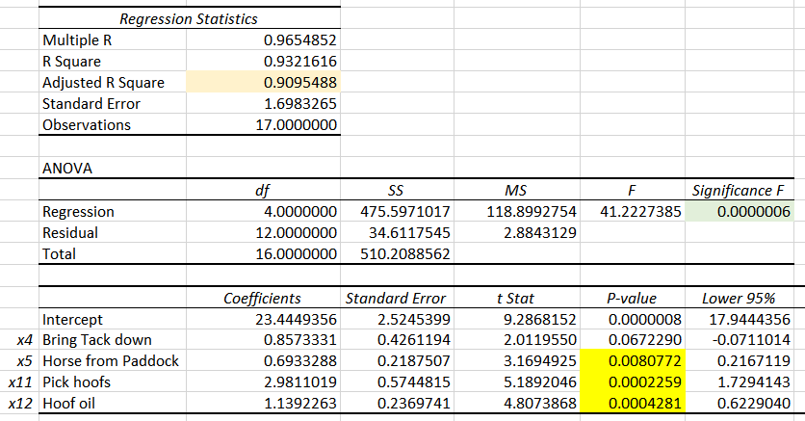
Multiple Linear Regression Analysis
Regression Analysis of my Pre-Improved Model
In looking at my data, it seems practical to me (based on my Pareto Chart) and just reviewing the data – that there were certain variables that were influencing my total preparation time. Some of these were not under my control, others could be improved, changed, or removed.
1st Iteration Analysis
As shown, I did have a low significance F (.0002), so I knew that at least one of my coefficients was doing a good job predicting my total time. Adjusted R² was also strong with .9268, so I ran my regression again using only x4, x5, x7, x8, x11 and x12.
Multiple Linear Regression Process
I did several multiple linear regression analyses with my data removing variables as they no longer seems significant.
The first model I ran was with the following x-variables:
x4 – Bring tack down
x5 – Horse from paddock
x6 – Put horse on crossties
x7 – Curry / shed blade
X8 – Hard brush
x9 – Soft brush
x10 – Brush mane and tail
x11 – Pick Hoofs
x12 – Apply hoof oil
2nd Iteration
1st Iteration
2nd Iteration Analysis
The significance F was smaller (.0000025) and Adjusted R² was larger (.9333), so I ran one more iteration with just x4, x5, x11 and x12.
3rd Iteration Analysis
The significance F was even smaller (.0000006) but Adjusted R² was smaller (.9095), but it became clear to me that x4, x5 and x12 all were impacting predicting the total time for preparation.
Note: I selected these input variables because I have little control over tacking my horse (x13). Over the last 40 years I have found every shortcut possible. Horses are animals and can be distracted or uncooperative. This is not something I can control. In addition, walking my horse to the ring (x14) is dependent on things I cannot control - how many others are also tacking horses on the aisle, how quickly they move, how long I have to wait to enter the ring due to activity in the ring – also beyond my control.
3rd Iteration

Slide 12
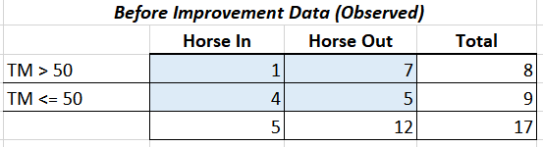
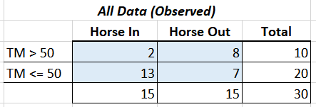
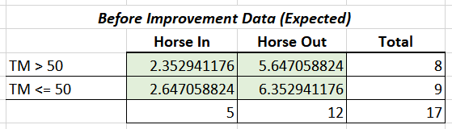
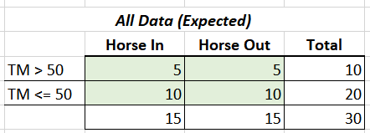
Chi-Squared Test for Independence
Determining the Test for Chi-Squared Test for Independence
There were two discrete variables that were captured as part of my data measurement. The Chi-Squared test for independence was to determine if the horse was outside or inside (x1) when I arrived to ride had a relationship to the total preparation time (y).
NOTE: Risks of Sample Size
Unfortunately, my sample size if very small and does not meet the requirements for a Chi-Squared test, but I ran the analysis regardless. In my case, the small sample size probably did affect the conclusions, as I had to accept the null hypothesis that the location of my horse (inside or out) and how long it takes me to prepare for riding are independent.
Hypothesis
H₀ = Horse Location and Total Preparation Time are Independent
H_{a} = Horse Location and Total Preparation Time are not independent
α = 0.05
Categories: Total Minutes > 50 (defect) and Total Minutes ≤ 50 (desired)
For More Fun
I did the test again with both before and after improvement data – where I had improved the process by having someone bring my horse inside each day.
Probability Result
Using the CHISQ.TEST function in Excel, the probability for this data was p = 0.149072804 so approximately 0.15 which is larger than our α = 0.05, so we would Accept our H₀ and conclude that horse location (inside or out) and the total preparation time are indeed independent.
Result of All Data
In this case, our p = 0.02013675 meaning that I would Reject the H₀ and conclude that horse location (inside or out) and the total preparation time are not independent and there is some affect on the total time based on horse location.

Slide 13
Is My Process In Control?
Now I need to confirm that my process is in control. In this case, I looked at all the data. If a data point is out of control, this is a signal that something might need to be investigated. We also want to look to see if there are any patterns. In my data, the first 17 day points represent my pre-improved process and the last 13 points represent my improved process.
Since I only have one data point in my continuous data per day (total time per day to prepare to ride) or n = 1, then I must do a moving range charts (xMR and iMR).
Control Chart (xMR)
For the xMoving Range Chart, the following information was used:
mRbar = 6.186207 = Centerline
UCL = D4*mRbar = 16.935875
LCL = D3*mRbar = 0.00
D4 = 3.27 from chart with n = 2
D3 = 0.00 from chart with n = 2
Control Chart (iMR)
For the Individual Moving Range Chart, the following information was used:
x̅ = 47.74333
UCL = x̅ +E2*mRbar = 64.19864
LCL = x̅ -E2*mRbar = 31.28802
E2 = 2.66 from chart with n = 2
The above charts indicate that the process is under control, with the exception of Day 5 (10/14/2018). On this day, I took more than over 11 minutes to bring my tack downstairs, 5 minutes to bring my horse in (he was likely eating and did not want to come to me) and then 14 minutes to take up. I must have been chatting and distracted that day, or my horse was uncooperative. In addition, the overall time continues to remain lowers after improvement. Need to monitor to maintain that improvement.

Slide 14
Overall Outcome and Conclusions
Overall Conclusions
I found some overall conclusions based on the tests that I used as well as the data collection that I felt were worthy of sharing.
Biggest Impact: I was able to shave off, in most cases, 10 minutes off my preparation time, so my goals were met!
Conclusions
Distraction - There were times when my process went a bit off target by talking to others and being distracted even though I knew I had a time constraint. I believe I became more aware of this and tried to minimize this in my post-improvement process and that had overall benefits. I am very chatty and did become a hinderance to my process.
Uncontrollable Forces – The process I tried to improve has many things that are completely uncontrollable and I got frustrated sometimes. These include:
Dirty Horse - Some days, they come in from outside clean and brushing and other tasks are a breeze. Other times, they decide to roll around in the mud. There is nothing that can control this, so it had an effect on my data, but was out of my control.
Cooperation – These are animals and some times they just do not feel like cooperating. For example, instead of coming to the gate when asked in the paddock, they may decide to play tag with you instead. Or, they may not stand still on the cross ties when you try to put their boots on or try to pick up their feet.
Other People – At a barn with over 40 horses, there are always others preparing to ride, riding or untacking and putting horses away. How much time it takes to get people’s attention so you can pass them on the narrow aisle, or get into the ring while they are riding, etc. is something that it not something I can control.
Traffic – sometimes my entire process was out of whack because I was stuck in traffic after work and got to the barn much later. I still went through the process on these days, but this is something that I cannot control.
Awareness – this goes back to distraction. Once I started tracking my time, I became more aware. I instinctively started to do things faster. I also found that I was encouraged to improve by just the mere task of keeping track of how much time things actually take. Much of this just happened by default.
Analysis – only work with what you can control, not what you cannot.

Slide 15
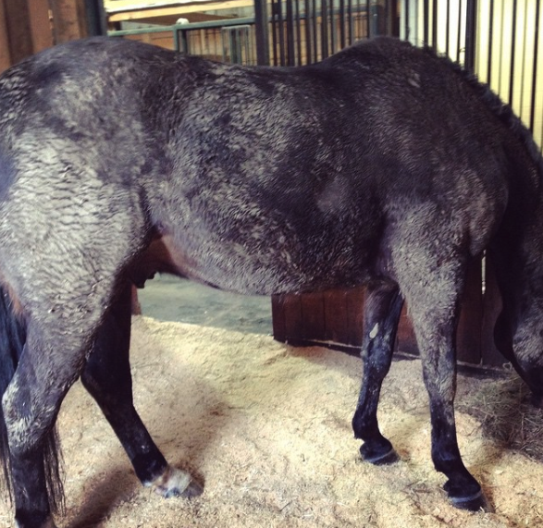
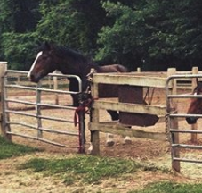
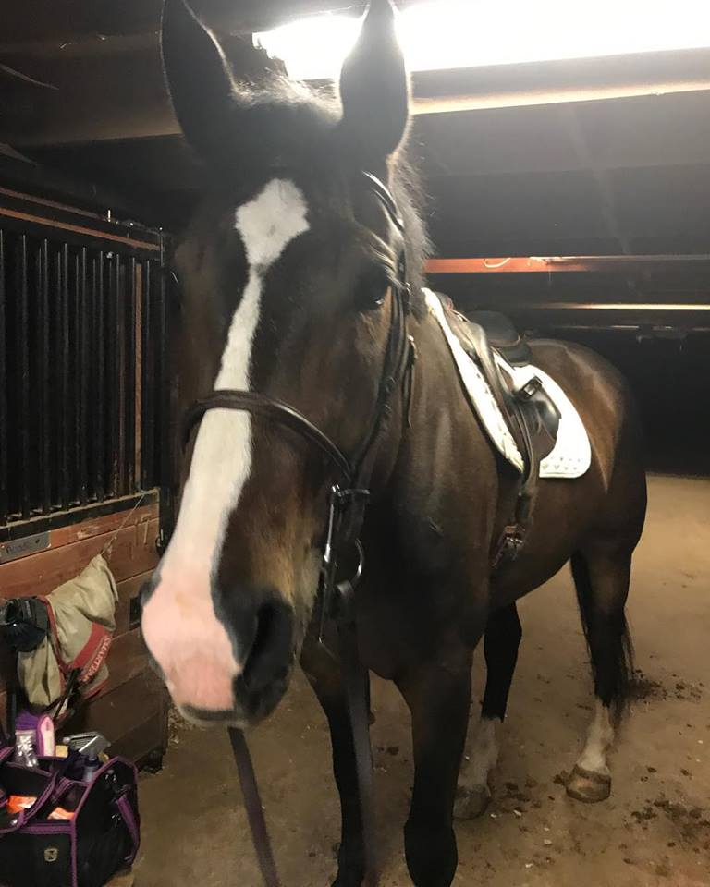
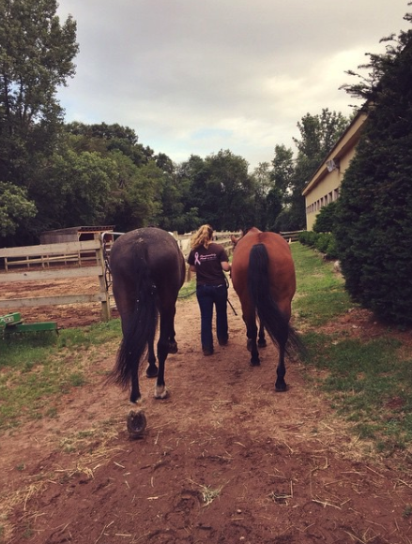
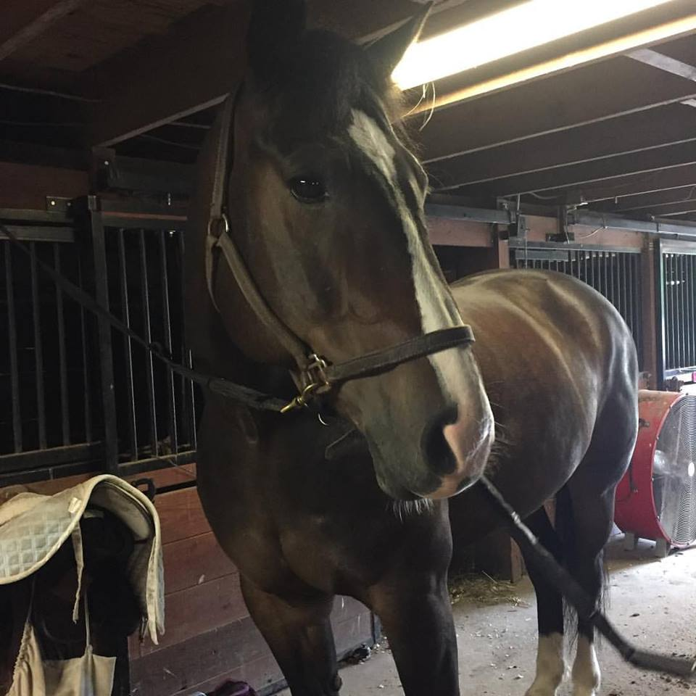
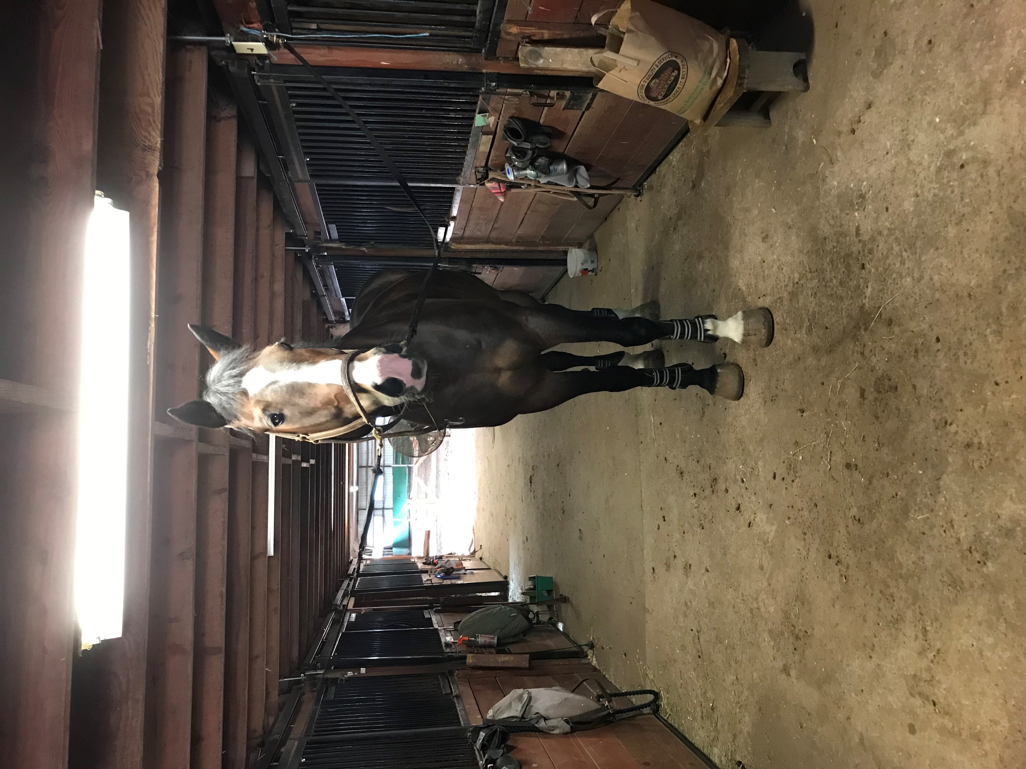
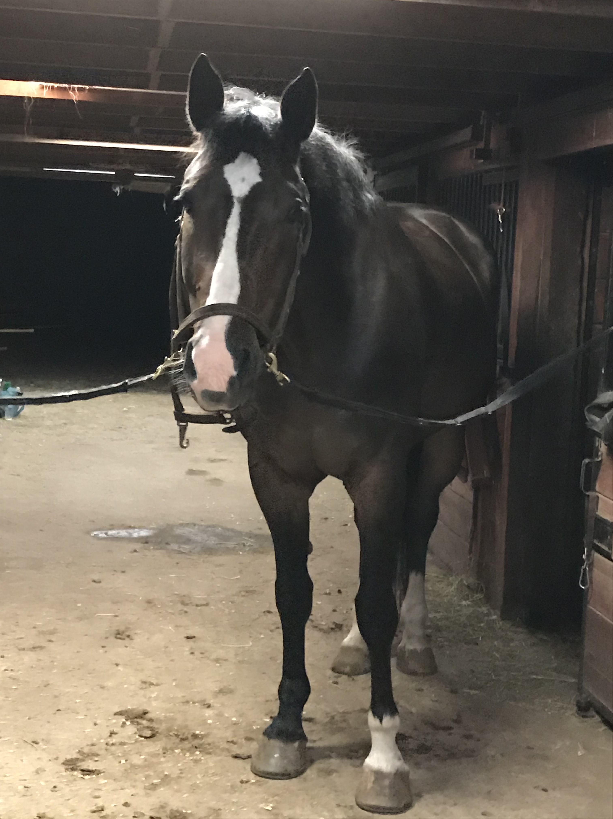
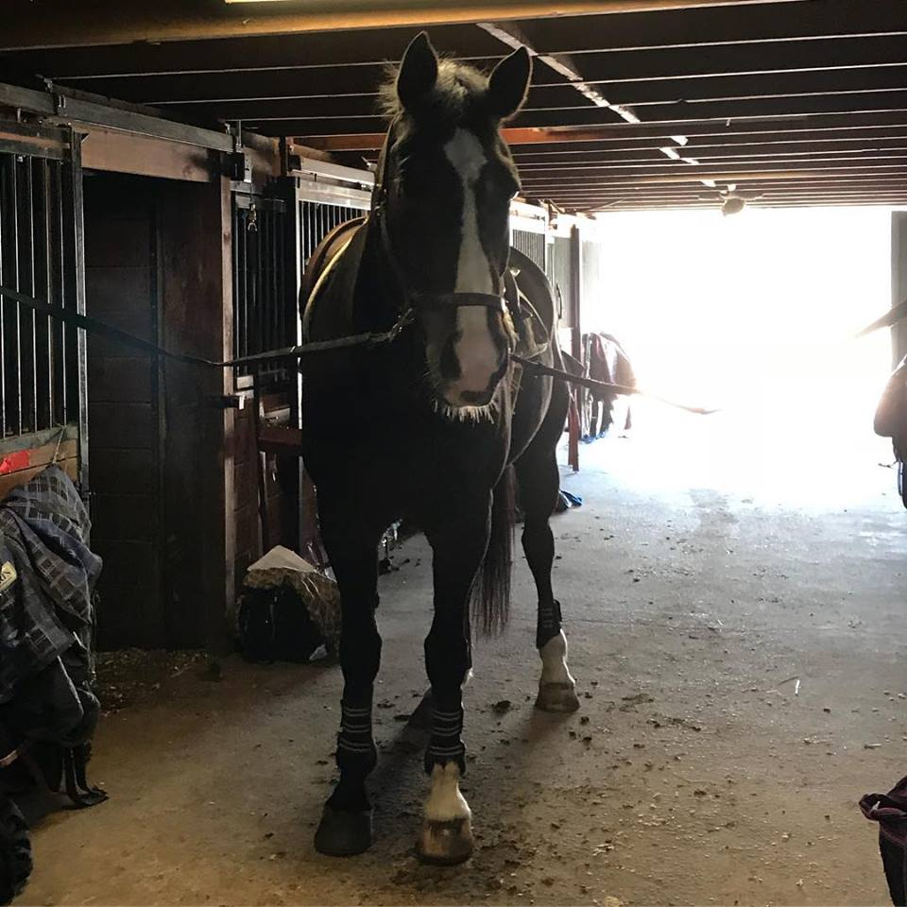
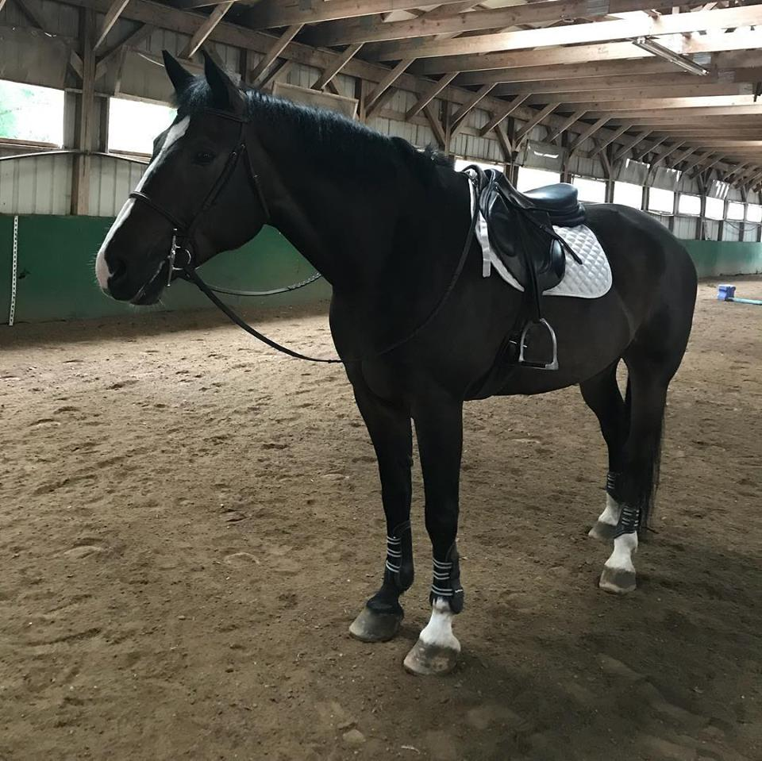
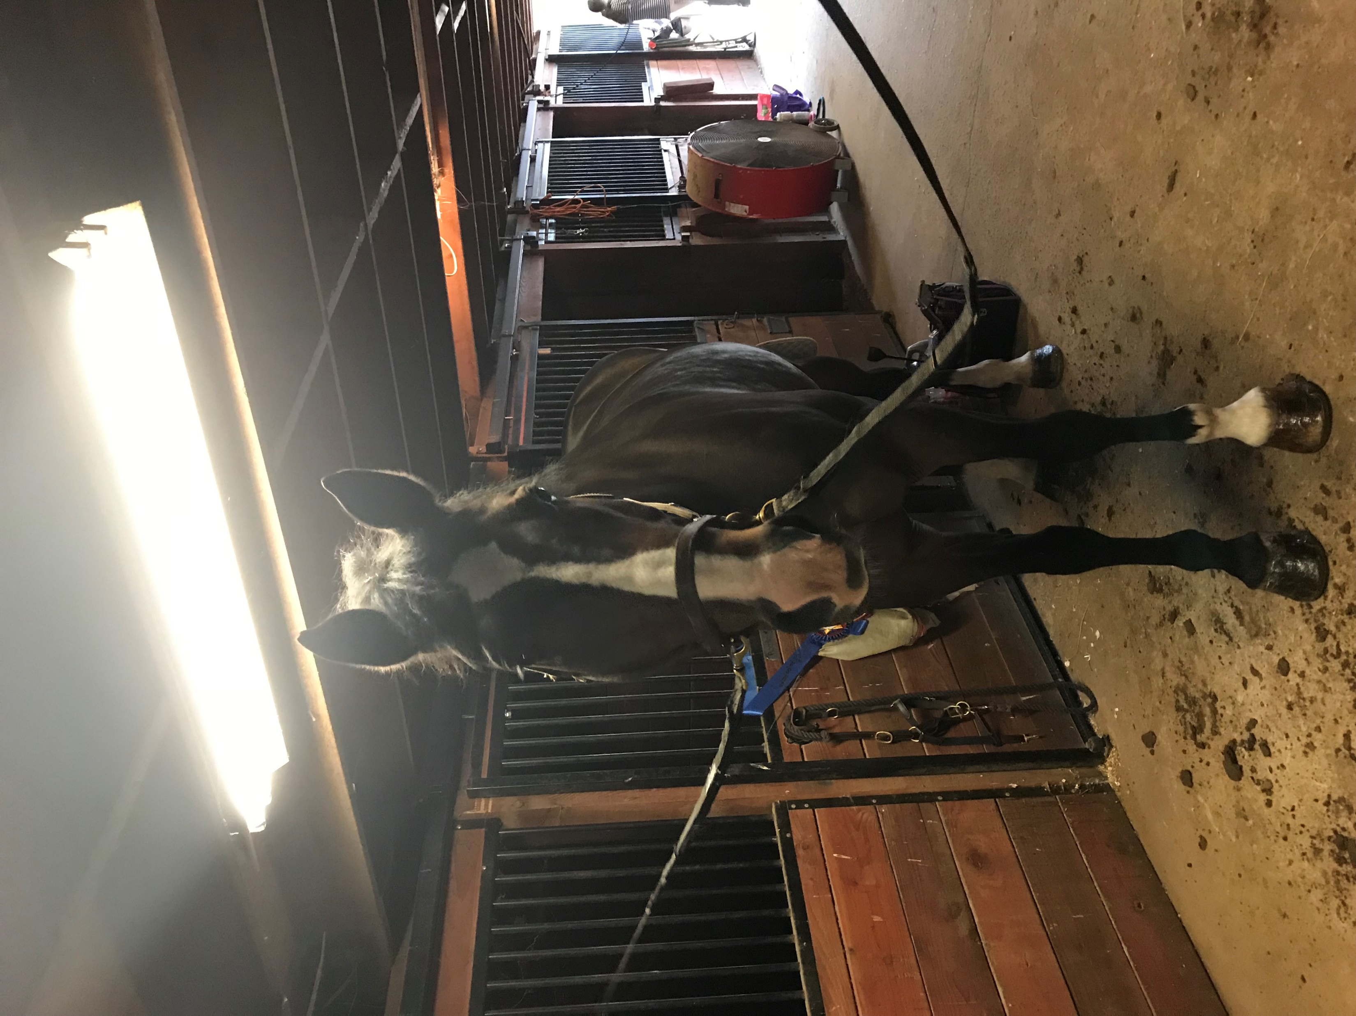
Photo Background
Photos for Background
Since my use case for this project can be considered a bit different and hard to visualize, I felt it might help to provide some photos to back up my data.
Horse in Paddock in relationship to Barn
Horse Paddock (see shed location)
(Typical) Horse Before Preparation
Riding ring entrance
brushes
Saddle/tack
View from Horse on Aisle to Ring for riding
Horse Aisle with Stall, Brushes and Tack Available
Horse Hoof Before and After Oil
Horse Clean, Brushed and Tacked for Riding

